Slide 1
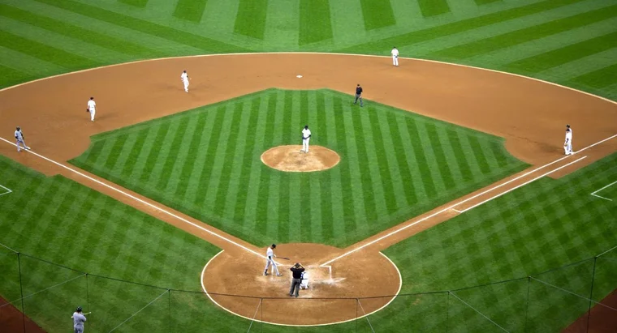
Baseball player selection in fantasy baseball leagues
Ben Lacar

Slide 2
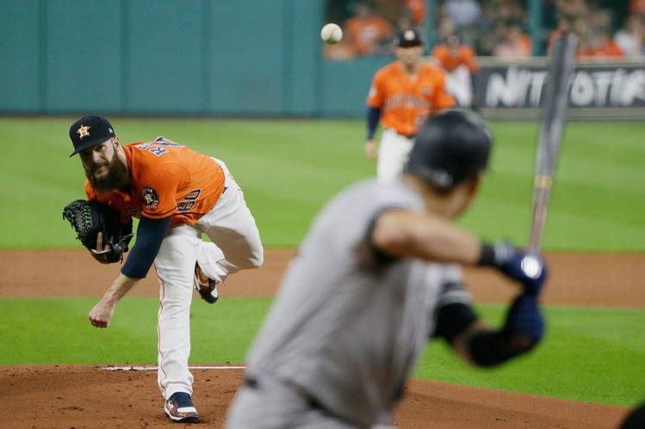
A baseball player’s contribution to winning depends heavily on the batter-pitcher matchup

Slide 3
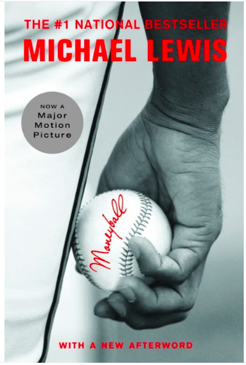
“Moneyball” changed how baseball selected players on a season-long roster
The analysis highlighted in Moneyball determined that players who got on-base, especially by walks, were being undervalued.

Slide 4
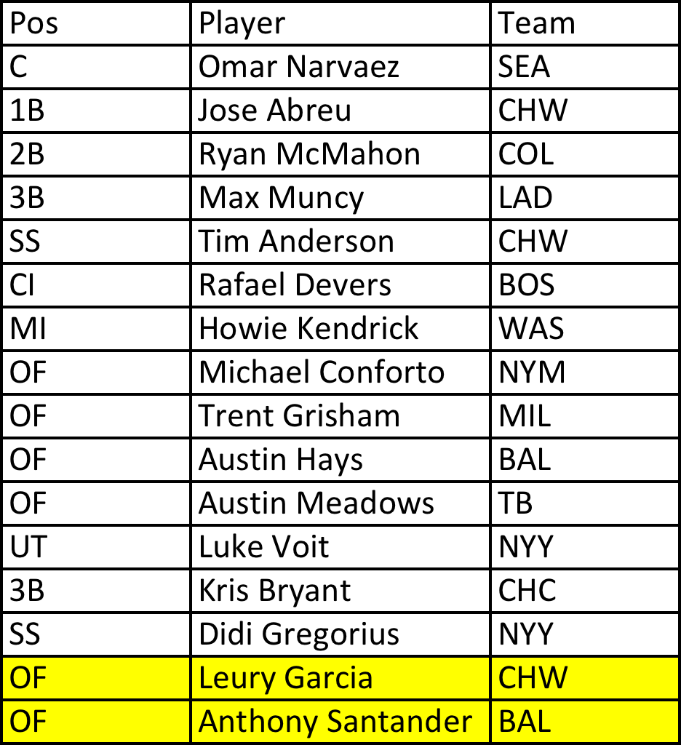
Fantasy baseball represents a projected market of $8.6 billion for 2020
Do I play Leury Garcia or Anthony Santander today?
Insight Baseball is a tool to assist in daily player selection.
Notes:
Fantasy baseball has over 11 million participants. The winners of leagues collecting entry fees and host platforms receiving a commission.
A participant's success depends in part on daily player selection.
Participants must rely on their own research or use a site's recommendation, which uses black-box algorithms behind pay walls.

Slide 5
Webapp: Insight Baseball
Inputs:
Player A – opposing pitcher X – game site (home/away)
Player B – opposing pitcher Y – game site (home/away)
Output:
Player recommendation (A or B)
Uncertainty value

Slide 6
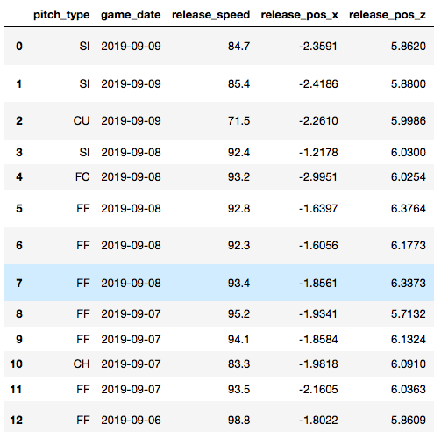
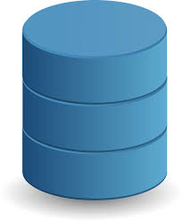
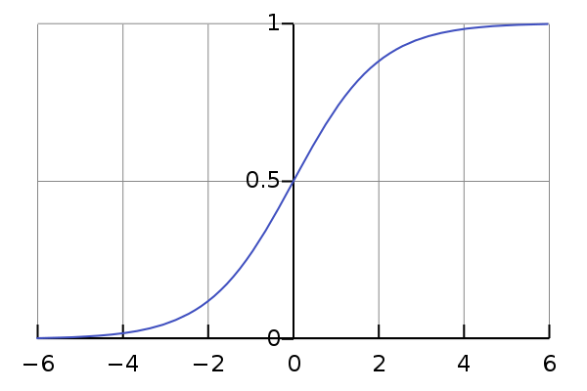
Methods
pybaseball API
2,174,906 pitch-by-pitch entries
(2017-2019 seasons)
Construct features of batter and pitcher performance, game conditions for each player
Verification
Statistics of Player A
“Recommend selecting Player B”
Statistics of Player B
Build a model and provide recommendation based on prediction probability of getting on base
Compare prediction with actual performance on given date

Slide 7
Features that may predict a batter’s ability to get on base
Batter
Batting side (L or R)
Player value
On-base percentage
Slugging percentage
On-base plus slugging percentage
Walk percentage
Strikeout percentage
Pitcher
Throwing arm (L or R)
Player value
Historical walks+hits rate
ERA
Walk percentage
Strikeout percentage
Game condition
Home or away
232,703 rows (each at-bat from 2017-2019)
Categorical variables, including batter and pitcher name, are one-hot encoded

Slide 8
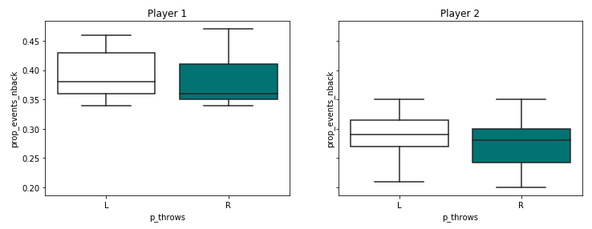
Handedness of pitcher can affect batter performance
Significant difference in batter on-base percentage between pitcher handedness

Slide 9
Current model performance
class | precision | recall | f1-score | support
0 | 0.70 | 0.52 | 0.60 | 62864
1 | 0.35 | 0.53 | 0.42 | 30218
accuracy |  |  | 0.52 | 93082

Slide 10




B.S. in Biochemistry
Ph.D. in Neuroscience
Postdoc in Neuroscience
Product Applications Scientist
Bioinformatics Scientist
Something education related
Ben Lacar, Ph.D.
ben.lacar@gmail.com
linkedin.com/in/lacar/
github.com/benslack19
benslack19.github.io

Slide 11
Additional things to try
Add features
Whether game is day or night
Other models

